Slide 1
PROJECT TITLE

Slide 2
EMPLOYEE DATE ANALYSIS USING EXCEL
STUDENT NAME: SHALINI SHRI.S.P
REGISTER NO : 312216398
DEPARTMENT : III BCOM(COMPUTER APPLICATION)
COLLEGE :SHRI SHANKARLAL SUNDARBAI SHASUN Jain COLLEGE FOR WOMEN

Slide 3
AGENDA
1.PROBLEM STATEMENT 2.PROJECT OVERVIEW 3.END USERS 4.OUR SOLUTION ANDPROPOSITION 5.DATASET DESCRIPTION 6.MODELLING APPROACH 7.RESULTS AND DISCUSSION 8.CONCLUSION

Slide 4
PROBLEM STATEMENT
In the realm of employee performance analysis, a key issue often encountered is the challenge of accurately and fairly assessing the diverse skills and contributions of employees within an organization. This can lead to difficulties in providing meaningful feedback, setting appropriate goals, and ultimately optimizing individual and team performance. Addressing this problem requires the establishment of clear and objective evaluation criteria, the implementation of effective performance measurement tools, and the cultivation of a supportive and growth-oriented work environment. By tackling these challenges head-on, organizations can enhance their ability to evaluate and improve employee performance effectively.

Slide 5
PROJECT OVERVIEW
performance review is a formal assessment in which a manager evaluates an employee's work performance. Also called a performance appraisal or an employee evaluation, it can be structured in different ways to effectively identify strengths and weaknesses, offer constructive feedback, and set goals for the future.

Slide 6
WHO ARE THE USERS
These end users will utilize the insights and recommendations generated by the Employee Performance Analysis project to inform their decisions, drive business outcomes, and enhance employee growth and development.

Slide 7
THE WOW IN OUR SOLUTION
You need to be able to articulate what is exciting about your company in a few sentences that connect with both the head and the heart of the listener. You have to make logical sense and get the listener's pulse to speed up. You want the reaction to be, “Wow! I'd really like to find out more.” Not, “How interesting..

Slide 8
OUR SOLUTION AND ITS VALUE PROPOSITION
FILTERING
MISSING VALUES
CONDITION FORMATING -BLANK VALUES
PIVOT
TABLE CHART

Slide 9
DATASET DESCRIPTION
EMPLOYEE DATE SET –KAGGLE
26 FEATURES
FEATURES-9 FEATURES
EMP ID
GENDER -MALE, FEMALE
PERFORMANCE
BUSINESS UNIT
NAME
RATING -NUMERICAL

Slide 10
MODELLING
MODELLING
DATA COLLECTION
DATA CLEANING
TECHNIQUES
RESULTS
PIVOT TABLE
CHART GRAPHS

Slide 11
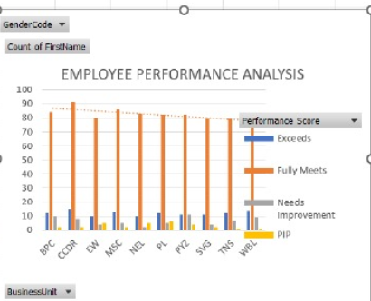
RESULT

Slide 12
CONCLUSION
In conclusion,when analyzing employee performance, it is essential to consider a variety of factors. Evaluating performance based on clear and measurable metrics is crucial for providing constructive feedback and facilitating growth. Additionally, recognizing and rewarding employees for their achievements can boost morale and motivation within the workplace. Effective performance analysis not only identifies areas for improvement but also highlights strengths that can be further developed. By fostering a culture of continuous improvement and open communication, organizations can enhance overall employee performance and contribute to long-term success.

